Slide 1
GRAMS PDU Description
Dave Durachka, Code 564

Slide 2
List of Sub-Systems in the PDU
Cold Time-Projection Chamber
Houses the SiPM Power Boards (x6), the SiPM Pre-Amplifier, Charge Pre-Amplifier, as well as Telemetry Power Boards
The High Voltage Board Inside the pressure vessel is also part of the Cold TPC section.
Warm Time-Projection Chamber
Houses the Shaper Power board, as well as the data acquisition power boards
CPU
Hub CPU and DAQ CPU power boards are housed here
Time of Flight Section
This houses the Time-Of-Flight Power Board.

Slide 3
Design Philosophy
Each of the sub-systems will be powered from a single DC-DC Conversion done on the Main PDU Box. This box will receive the +28V from the battery pack on the balloon gondola and convert down to +12V that will drive each Sub-System’s PDU Board.
Each sub-system will have a dedicated power board that will receive the +12V and convert down or up to the prescribed value needed for the sub-system.
Requirements have been captured for the PDU system and agreed to by everyone.
An Interface Control Document (ICD) will accompany this presentation to provide completeness to this design.

Slide 4

Harnessing Nomenclature
Classes of Harnessing
Input Power Cables to the PDU (Preceded with a P) at the box level
Telemetry Cables within the PDU (Preceded with a T) at the box level
Cables providing power From the PDU (Preceded with a J) at the box level

Slide 5
COLD TPC PDU

Slide 6
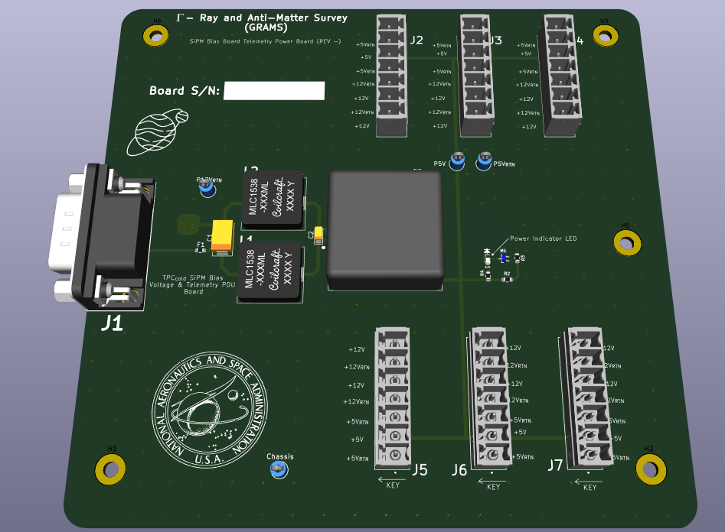
Cold TPC SiPM Bias Power Board
The Image to the left is describing the board providing power for both the SiPM Bias as well as the telemetry section of the SiPM Bias Board.
J2 – J7 will provide +12V and +5V to each SiPM Bias Board.
This board will receive +12V from the Main DC-DC PDU Board.

Slide 7
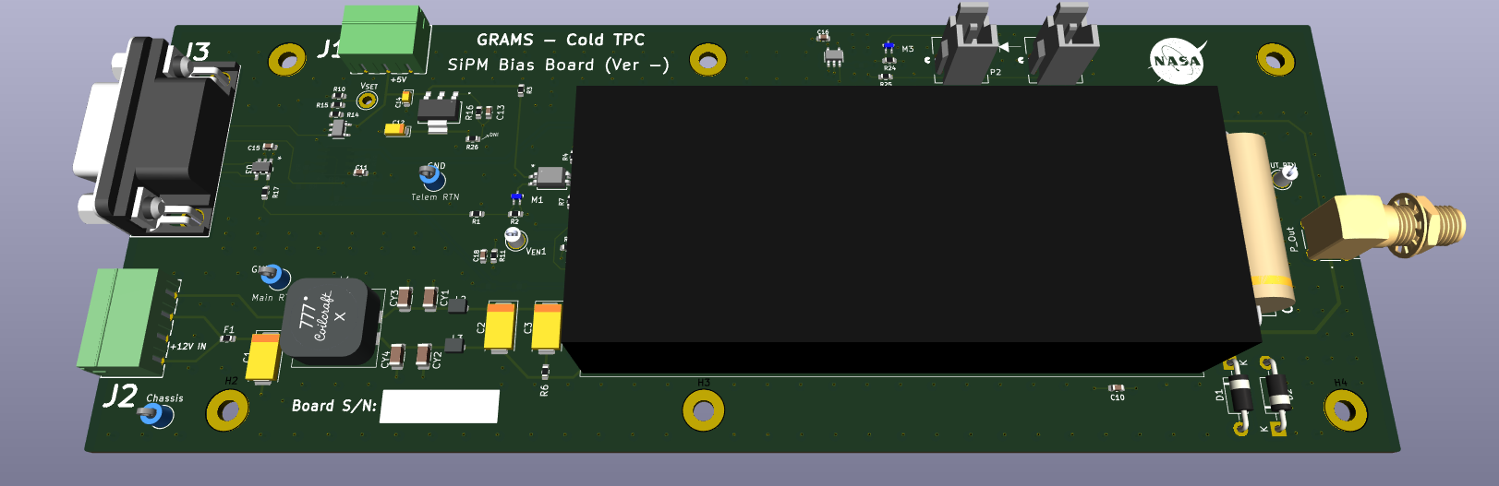
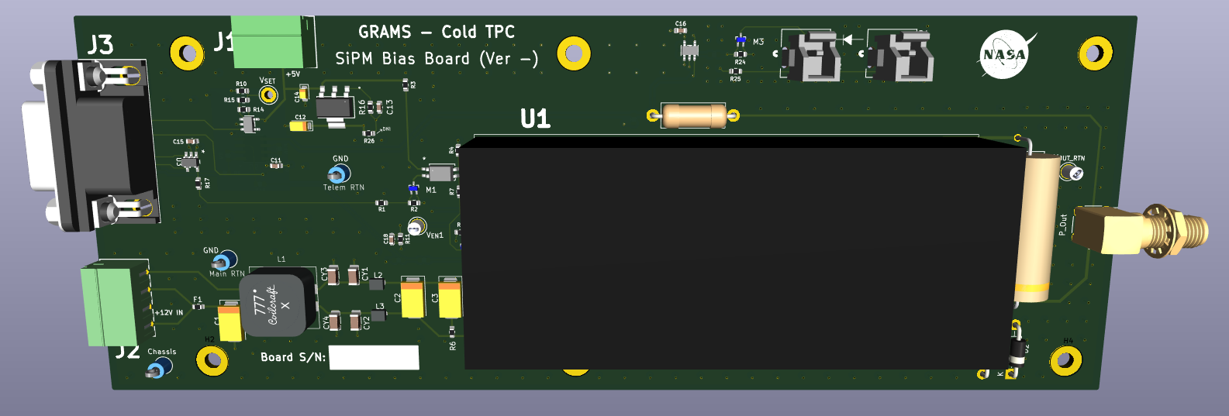
Cold TPC SiPM Bias Board
The SiPM Bias Board is shown to the Right.
J1 and J2 receive the +12V and +5V (with returns) respectively.
J3 is the command / control, and telemetry portal to this board.
U1 is the 1/16A12-P4-I5 converter manufactured by Ultravolt and will provide the prescribed voltage rail to each SiPM within the Cold TPC Section.

Slide 8
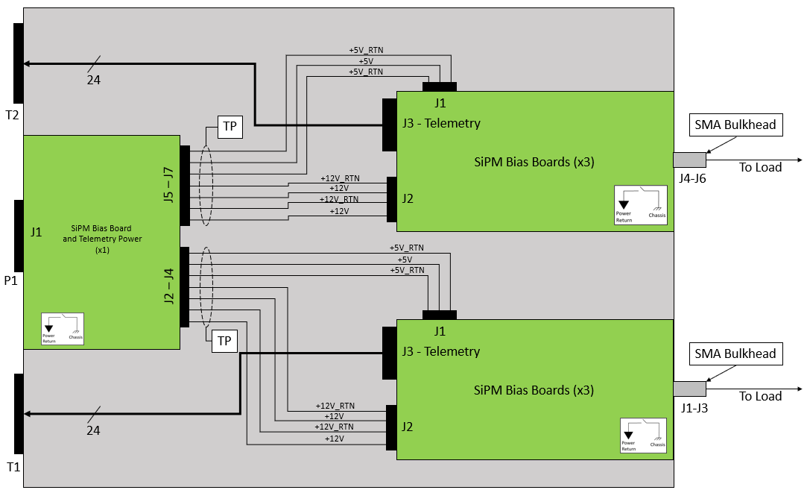
Cold TPC SiPM Bias Box Diagram
Chassis
W-100
W-102 - 104
W-105 - 107
W-101

Slide 9
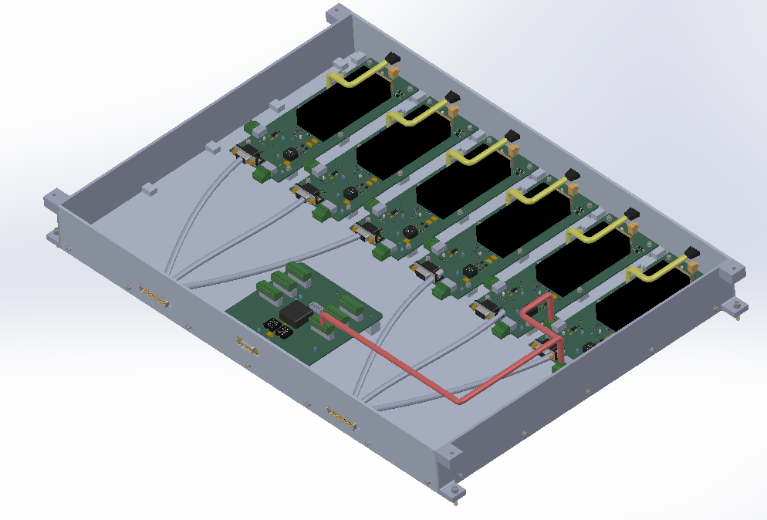
Cold TPC SiPM Bias Box Design

Slide 10
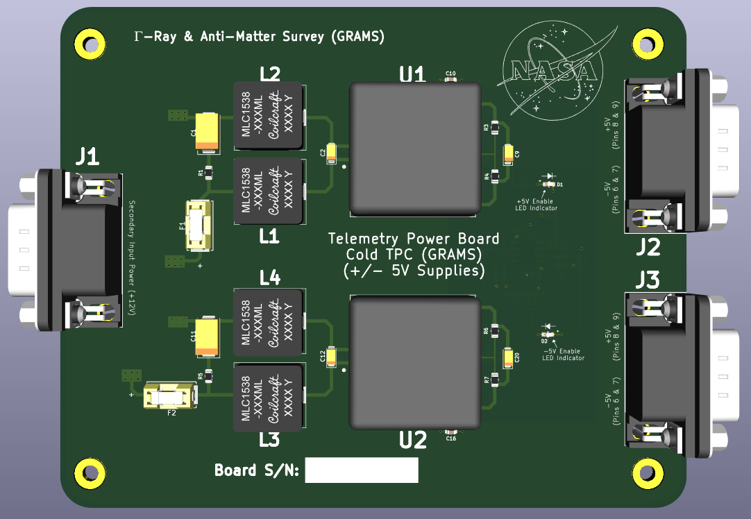
Cold TPC Charge and SiPM Pre-Amp Power Board
The image to the left describes the power board providing +/- 5V for the telemetry sections of the PDU Boards servicing the Charge and SiPM Pre-Amplifier Sub-Systems

Slide 11
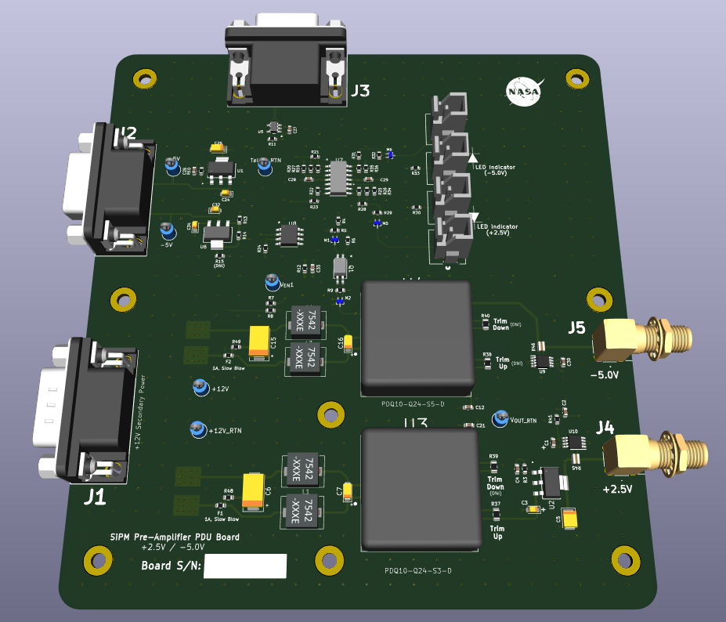
SiPM Pre-Amplifier Board
The Image to the Right is showing the SiPM Pre-Amplifier PDU Board.
J1 receives +12V from the Main PDU Board
J2 receives the +/- 5V from the Charge and SiPM Pre-Amplifier Board shown in the previous slide.
J3 Provides the telemetry from this board.
J4 and J5 deliver +2.5 / -5 respectively to the load.

Slide 12
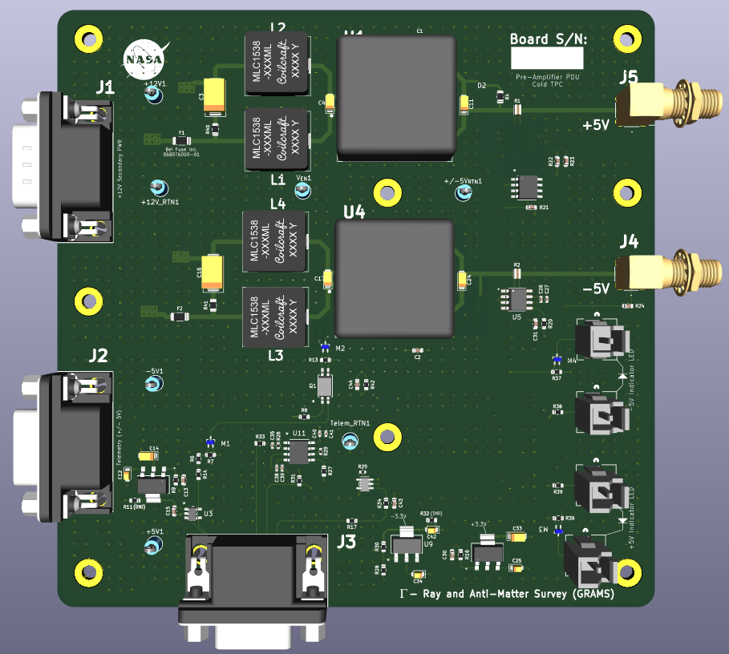
Charge Pre-Amplifier Board
The image to the right is showing the Charge Pre-Amplifier PDU Board
J1 is receiving the +12V from the Main PDU Board
J2 is receiving the +/- 5V from the Charge and Pre-Amplifier Power board
J3 is providing the telemetry from this board
J5 and J4 are providing the +/- 5V to the Load.

Slide 13
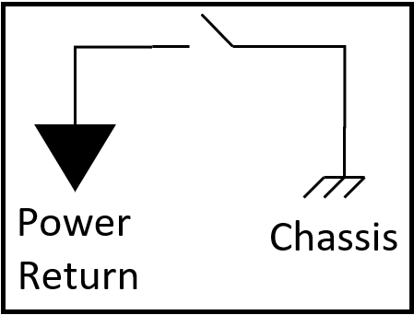
Cold TPC Charge and SiPM Pre-Amp Box Diagram
W-110
15
Telemetry Values
SiPM Pre-Amplifier PDU Board
T3
J3 (Telem)
W-112
8
+12V
8
+/- 5V
+12V_RTN
+/- 5V_RTN
J2 (Telem power)
P2
SiPM and Charge Pre-Amp Power Board
J7
(-5V) J5
To Load
W-114
J1 (Secondary PWR)
(+2.5V) J4
(+/-5V Telemetry PWR) J2
To Load
J1 (Secondary Power)
J8
(+/-5V Telemetry PWR) J3
W-115
J9
J1 (Secondary PWR)
(+5V) J5
To Load
P3
(-5V) J4
To Load
W-113
8
+12V
8
J10
+12V_RTN
+/- 5V
J2 (Telem power)
+/- 5V_RTN
P4
J3 (Telem)
12
Charge Pre-Amplifier PDU Board
W-111
Telemetry Values
T4
* All harnessing called out in this drawing are Twisted Pair

Slide 14
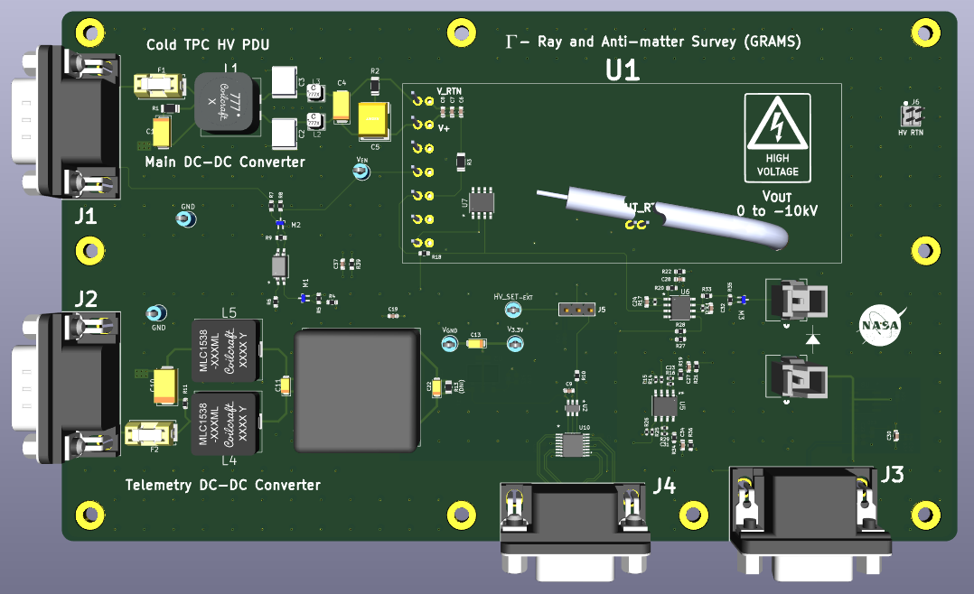
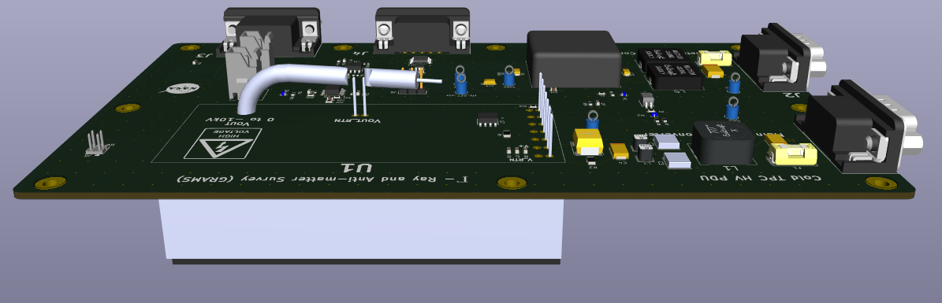
High Voltage Bias (-10kV) for Cold TPC
Images to right show the HV PDU board for the Cold TPC
J1 and J2 receive the main input power of +12V. The pinout orientation are identical, swapping these will not harm anything.
J3 is the Telemetry I/O
J4 provides a means to configure he onboard DAC and provide the enable signal. This board will reside in its own box.
DC-DC Converter resides on bottom of the board

Slide 15
WARM TPC PDU

Slide 16
Warm TPC Boards
The Warm TPC PDU has four boards associated with it
DAQ +3.3V
DAQ +/- 5V
DAQ +12V
The Shaper
The Shaper is a larger board and can be put into its own box, it also doesn’t interact with the other boards as part of the PDU design.
All of the DAQ boards are meant to work with each other and should be part of the same box.

Slide 17
CAEN-NEVIS DAQ PDU Box Diagram
P5
W-120
J11
To Load +5V
8
J2 (Secondary Power)
J5
T5
W-121
J4
To Load -5V
13
J1 (Telemetry, CMD/CTRL)
P6
J6
(Telemetry Power Rails)
J12
W-122
J3 (Secondary Power)
8
TP-1
+/-5V +/-5V RTN
W-129
T6
+5V +5V RTN
W-123
J2 (Telemetry)
J3
(+5V for Telemetry Rail)
J13
9
J4
To Load 12V
P7
W-124
J1 (Secondary Power)
8
+5V +5V RTN
T7
W-125
J4 (Telemetry)
J1 (+5V for Telemetry Rail)
J14
8
To Load 3.3V
P8
W-126
J2
8
J2 (Secondary Power)

Slide 18
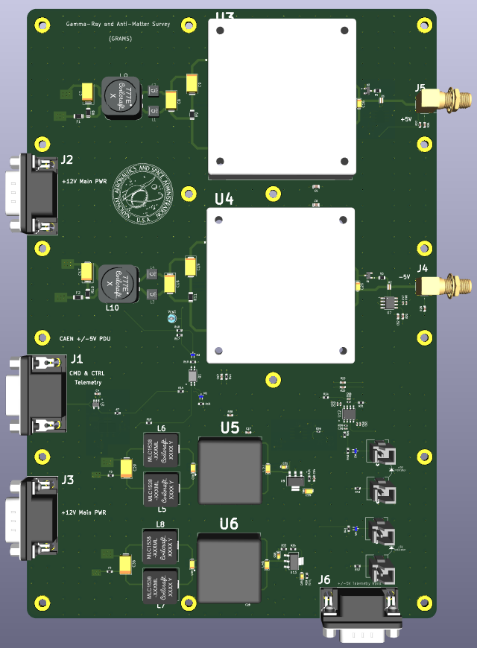
CAEN-NEVIS +/- 5V PDU Board
The +/- 5V Board is to the right. The top portion of the board is supplying the power to the sub-system load.
The +5V rail is spec’d at 8.5A
42.5W
The -5V rail is spec’d at 1.993A
9.9W
Both converters are the VHB75W-Q24-S5 and can supply up to 75W.
The total input power with these levels is ~ 60W for this board.

Slide 19
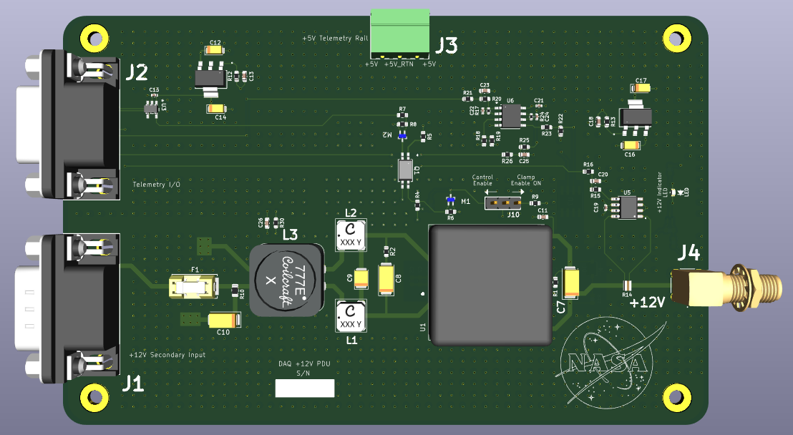
CAEN-NEVIS +12V Board
The +12V CAEN-NEVIS PDU Board is to the left.
The +12V supply is spec’d to pull 1.993A
23.9W
The converter on this board is the PDQ30-Q24-S12-D, which can provide 30W.
The input power on this board will be 26.5W

Slide 20
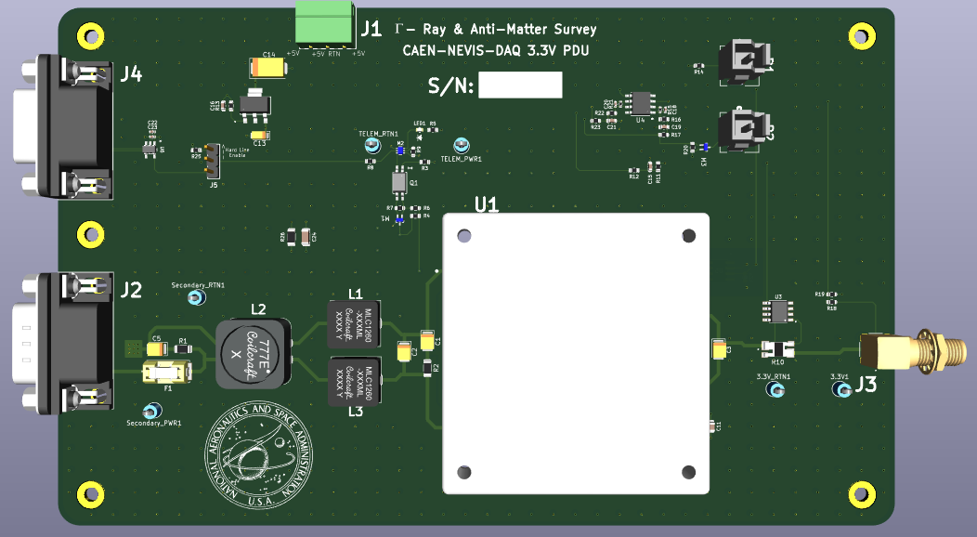
CAEN-NEVIS +3.3V PDU Board
The CAEN-NEVIS 3.3V PDU Board is to the right.
This rail is spec’d to supply 12.1A to the load.
40W
The converter on this board is the VHB75W-Q24-S5 and can supply up to 75W.
The input power for this board will be ~ 45W.

Slide 21
Shaper PDU Box Diagram
J4
J15
To Load +3.3V
J3
To Load -3.3V
J16
J6
J17
To Load +3.3V
P9
J5
To Load -3.3V
J18
J2 (Secondary Power)
J8
J19
To Load +3.3V
T8
J7
To Load -3.3V
J20
J1 (Telemetry, CMD/CTRL)
J21
To Load +3.3V
J10
TP-2
J9
To Load -3.3V
J22
J15 (Telemetry Power Rail from TP-1 Connector)
J23
To Load +3.3V
J12
J11
To Load -3.3V
J24
J14
J25
To Load +3.3V
J13
To Load -3.3V
J26

Slide 22
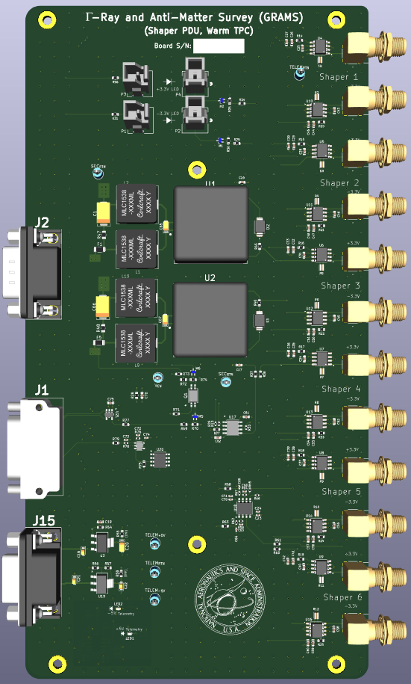
The Shaper Board
The shaper board is providing 6 pairs of +/- 3.3V rails.
The total power being pulled on the +3.3V rail is 1.485W
The total power being pulled on the -3.3V rail is 1.485W
At this power, the converters are approximately 80% efficient.
Pin ~ 1.9W each.

Slide 23
FLIGHT Computer PDU

Slide 24
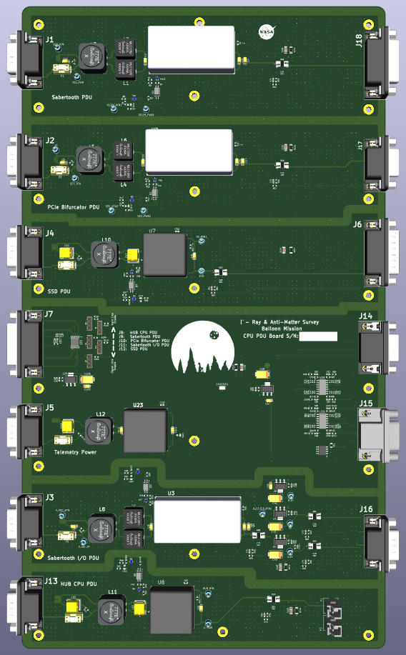
CPU PDU Board
The Flight Computer is supplying power to several separate loads. The PDU board is shown to the right.
The different sections of this board are outlined by the top-level metal down to the bottom layer, all connected to chassis. This is to not only delineate the circuits, but to handle any noise issues that may arise.
This board should have its own box.

Slide 25
CPU PDU Power Dissipation
Sabertooth PDU
Uses the PRC60-24-S12 for conversion, capable of 60W
Input power estimate: 55.3W
Sabertooth I/O PDU
Uses the PRC60-24-S12 for conversion as well
Input power estimate: 44W
PCIe Bifurcator PDU
Uses the PRC60-24-S12 for conversion as well.
Input power estimate: 39.5W
SSD & HUB PDU
Both use the PDQ30-Q24-S5-D converter, capable of 30W.
SSD: 5.8W || HUB CPU: 6.2W
Total Power Input: 12W
Sabertooth PDU
+12V, 4.2A
50.4W
Sabertooth I/O
+12V, 3A || +5V, 100mA +3.3V, 500mA
38.15W
PCIe Bifurcator PDU
+12V, 3A
36W
SSD PDU
+5V, 1A
5W
HUB CPU PDU
+5.5V, 1A
5.5W

Slide 26
CPU PDU Box Diagram
P10
J27
J1 (Secondary Power) Sabertooth PDU
(Sabertooth PWR) J18
P11
J28
J2 (Secondary Power)
PCIe Bifurcator PDU
(PCIe Bifurcator PWR) J17
P12
J29
J4 (Secondary Power)
SSD PDU
(SSD PWR) J6
T9
T10
J7 (Telemetry CMD/CTRL)
(Current Telemetry) J14
P13
T11
J5 (Secondary Power)
Telemetry Power
(Voltage Telemetry) J15
P14
J30
J3 (Secondary Power)
Sabertooth I/O PDU
(Sabertooth I/O PWR) J16
P15
J31
J13 (Secondary Power)
Hub Computer PDU
(HUB Computer PWR) P1, P2

Slide 27
Time-of-Flight PDU

Slide 28
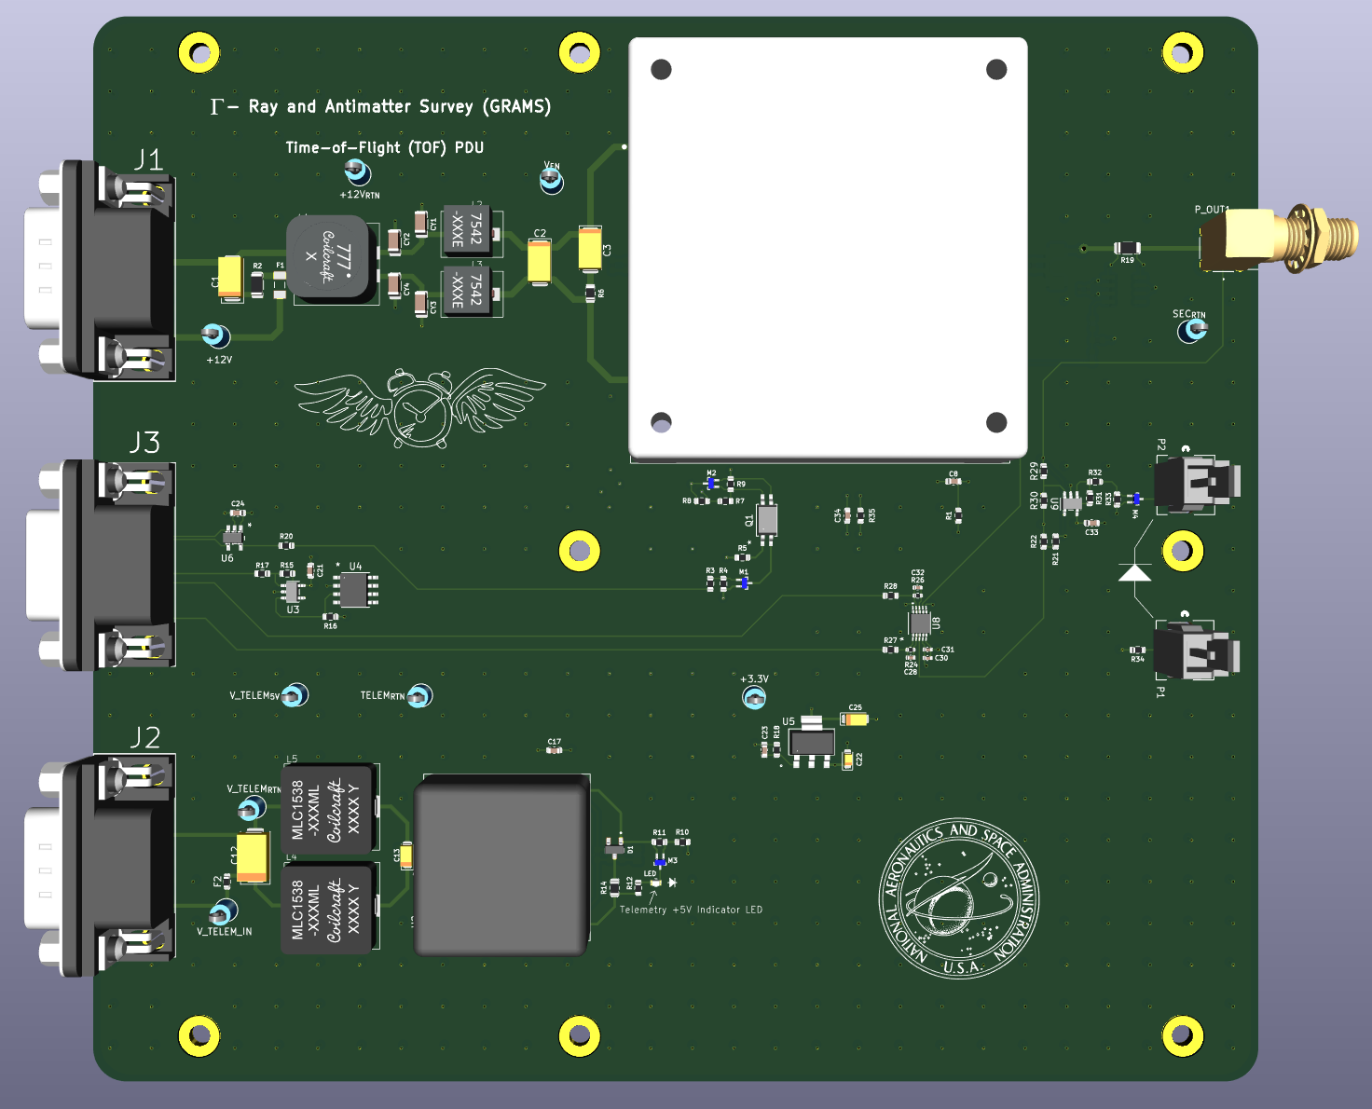
Time of Flight
The TOF PDU is shown to the right.
This rail is spec’d to pull 4A @ 12V
48W
Using the VHB75W-Q24-S12 converter to provide the +12V
Capable of 75W, with η = 83%
Input power estimate: 57.9W

Slide 29
TOF Box Diagram
P16
J1 (Secondary Power)
J32
+12V To Load
T10
J3 (Telemetry CMD/CTRL)
P17
J2 (Secondary Power)

Slide 30
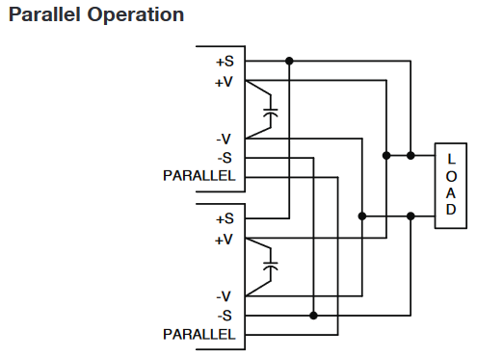
Total Power Draw
Would suggest we look at the QSB40024S12 converter by XP Power
Can supply +12V @ 400W
Can use two in Parallel
Total Power Demand on Main DC-DC Converter Box
Sub-System | Power Demand | Units
Cold TPC | 42.01 | Watts
Warm TPC | 141 | Watts
CPU | 160 | Watts
TOF | 60 | Watts
Total Power Needs | 403.01 | Watts
Current Draw @ 12V | 33.6 | Amps

Slide 31
Backup Slides

Slide 32
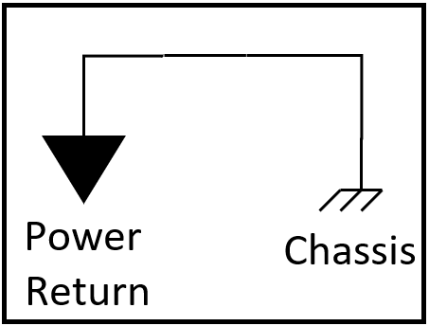
Cold TPC PDU Section
SiPM Bias Boards (x6)
SiPM Pre-Amp & Charge Pre-Amp
Main DC-DC
Converter Board
+28V
-10kV HV PDU
=
+12V
=
+12V RTN
+28V RTN
Warm TPC PDU Section
Caen/Nevis DAQ
Shaper
Flight Computer
HUB and DAQ Computer PDUs
Power
Return
Chassis

Slide 33
SiPM Bias Box (Cold TPC) Wiring Diagram
+5V_RTN
+5V
24
+5V_RTN
T2
J1
TP
J3 - Telemetry
SMA Bulkhead
SiPM Bias Boards (x3)
To Load
J5 – J7
+12V_RTN
J4-J6
+12V
J2
+12V_RTN
+12V
J1
SiPM Bias Board
and Telemetry Power
(x1)
+5V_RTN
+5V
P1
+5V_RTN
J2 – J4
TP
J1
J3 - Telemetry
SMA Bulkhead
SiPM Bias Boards (x3)
To Load
+12V_RTN
J1-J3
+12V
J2
24
+12V_RTN
+12V
T1

Slide 34
Warm TPC

Slide 35
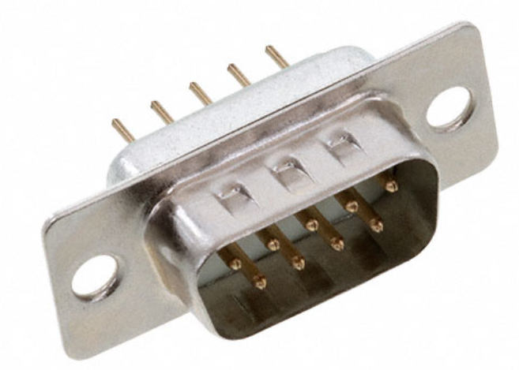
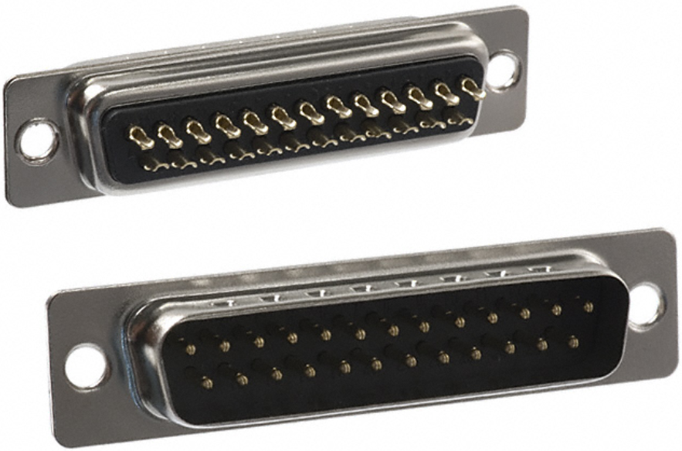
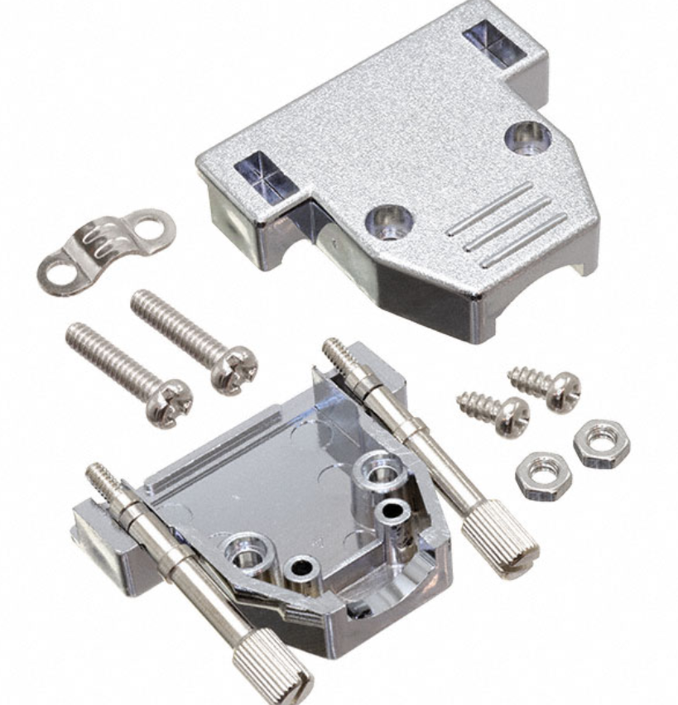
Würth Elektronik
61800924823
9-Pin D-sub
In-Line Connector
NorComp Inc. 171-025-103L001
25-Pin D-sub Panel Mount
TP
1
6
2
7
4
8
5
9
Chassis
1
6
2
7
4
8
5
9
Chassis
1
6
2
7
4
8
5
9
Chassis
TP
1
2
3
4
5
6
7
8
9
10
11
12
13
14
15
16
17
18
19
20
21
22
23
24
25
TP
TP
TP
TP
TP
TP
TP
TP
TP
TP
x
Chassis
Würth Elektronik
61801525311
9-Pos Back-Shell
NorComp Inc. 977-025-020R121
25-Pos Back-shell

Slide 36
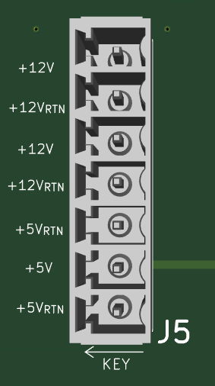
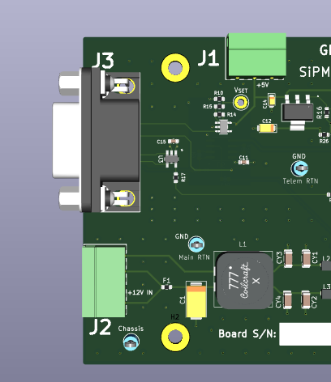
Telemetry Power Board
SiPM Bias Board
Telemetry Power is connected to J1 and J2 of the SiPM Bias Board

Slide 37
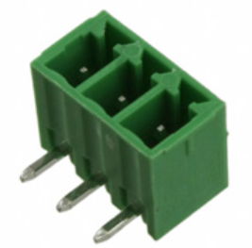
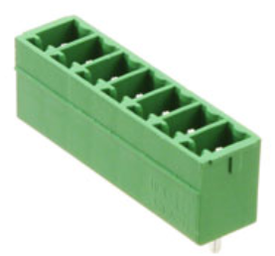
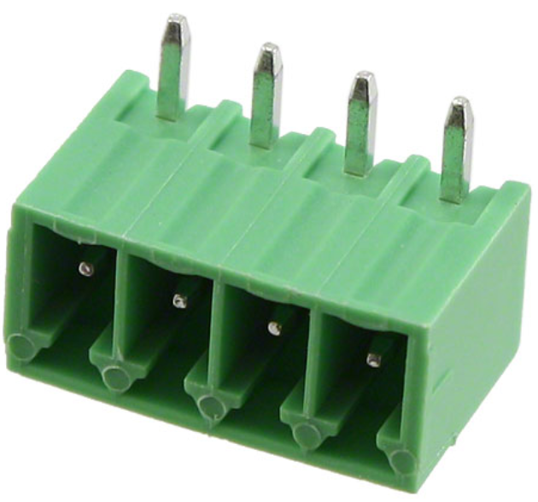
Würth Elektronik 691322310003
(J1)
Phoenix Contact 1803471 (J2 – J7)
1
2
3
1
2
3
4
5
6
7
TP
+5V RTN
Telemetry Power
Board
+5V
+5V RTN
SiPM Bias Board
TP
+12V
+12V RTN
+12V
2
1
4
3
+12V RTN
Würth Elektronik 691322310004 (J2)

Slide 38
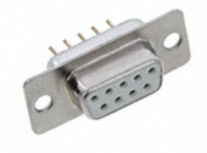
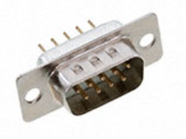
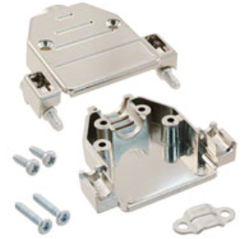
Wurth Elektronik
PN: 61800924923
Wurth Elektronik
PN: 61800924823
TP
Secondary RTN
1
6
2
7
4
8
5
9
Chassis
+12V
1
6
2
7
4
8
5
9
Chassis
TP
Secondary RTN
Side of the Box
(P2, P4)
TP
+12V
J1 on SiPM Pre-Amp -or- J1 on Charge Pre-Amp Board
Secondary RTN
TP
+12V
Secondary RTN
+12V
HARTING
PN: 09670150443
HARTING
PN: 09670150443

Slide 39
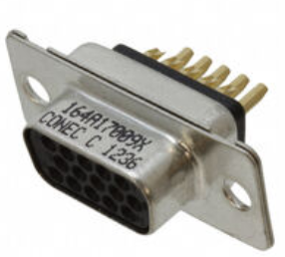
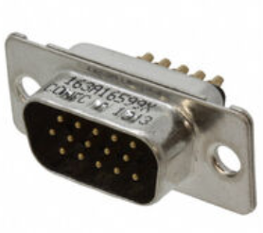
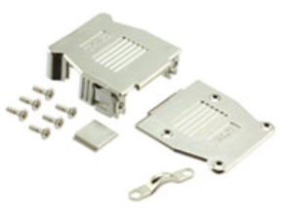
Amphenol CONEC
PN: 164A17009X
Amphenol CONEC
PN: 163A16599X
1
6
2
7
3
8
4
9
5
10
14
15
11
12
13
Chassis
TP
TEMP Telemetry
1
6
2
7
3
8
4
9
5
10
14
15
11
12
13
Chassis
TP
Telem RTN
-5V Voltage Telem
TP
Telem RTN
+5V Voltage Telem
TP
Telem RTN
T4 Connector on Cold-TPC PDU Box
-5V Current Telem
Cold TPC Charge Pre-Amp PDU Side
TP
Telem RTN
+5 Current Telem
TP
Telem RTN
Enable +
Enable -
Amphenol CONEC
PN: 16-001760E
Amphenol CONEC
PN: 16-001760E

